Slide 1
Descriptive Statistics and Data Visualization
Most of the slides are based on the course on Probability and Statistics by Prof. Kevin M. Riordan

Slide 2
Statistics
Many studies generate large numbers of data points
How to make sense of all that data?
Statistics is used to summarize the data, to provide a better understanding of overall tendencies within the distributions of scores.
helps in summarizing the results
helps us recognize underlying trends and tendencies in the data
helps in communicating the results to others

Slide 3
Types of Statistics
Statistics
Drawing conclusions about a population using statistics calculated on a sample considered to be representative of that population.
Use of statistical and graphic techniques to present information about the data set being studied.
Collecting , Summarizing, and describing data
Descriptive
Inferential
Gives you an idea of what is a typical or common value for a given variable.
Dispersion refers to how variable or “spread out” data values are
Measure of Central Tendency
Measures of Dispersion
Mean
Mode
Median
Range
Variance
Standard Deviation

Slide 4
Descriptive statistics
If we wanted to characterize the students in this class, we would find that they are:
Young
Fit
Male
How young?
How fit is this class?
What is the distribution of males and females?
Goal:
To visualize data, understand the patterns, and make quick statements about the system’s behavior
To understand relations among variables

Slide 5
Populations & Samples
In a survey, 250 college students were asked if they study regularly. 35 of the students said yes.
Responses of all students (population)
Responses of students from DU (sample)

Slide 6
Frequency Distributions
A frequency distribution is a table that shows classes or intervals of data with a count of the number in each class.
The frequency f of a class is the number of data points in the class.
Class | Frequency, f
1 – 4 | 4
5 – 8 | 5
9 – 12 | 3
13 – 16 | 4
17 – 20 | 2
Upper Class Limits
Lower Class Limits
Frequencies

Slide 7
Frequency Distributions
The class width is the distance between lower (or upper) limits of consecutive classes.
Class | Frequency, f
1 – 4 | 4
5 – 8 | 5
9 – 12 | 3
13 – 16 | 4
17 – 20 | 2
5 – 1 = 4
9 – 5 = 4
13 – 9 = 4
17 – 13 = 4
The class width is 4.
The range is the difference between the maximum and minimum data entries.

Slide 8
Constructing a Frequency Distribution
Example:
The following data represents the ages of 30 students in a class. Construct a frequency distribution that has five classes.
Ages of Students
18 | 20 | 21 | 27 | 29 | 20
19 | 30 | 32 | 19 | 34 | 19
24 | 29 | 18 | 37 | 38 | 22
30 | 39 | 32 | 44 | 33 | 46
54 | 49 | 18 | 51 | 21 | 21

Slide 9
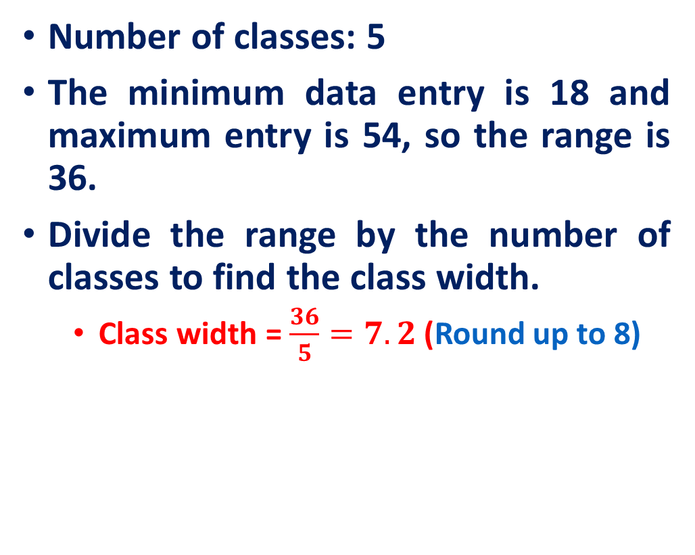
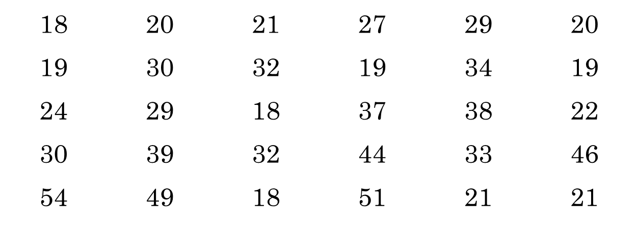
Constructing a Frequency Distribution

Slide 10
Constructing a Frequency Distribution
Lower limit and upper limits of classes will be
The lower class limits are 18, 26, 34, 42, and 50.
The upper class limits are 25, 33, 41, 49, and 57.
Class | Frequency, f
18 – 25 | 13
26 – 33 | 8
34 – 41 | 4
42 – 49 | 3
50 – 57 | 2

Slide 11
Relative Frequency
The relative frequency of a class is the portion or percentage of the data that falls in that class.
Class | Frequency, f | Relative Frequency
18 – 25 | 13 | 0.433
26 – 33 | 8 | 0.267
34 – 41 | 4 | 0.133
42 – 49 | 3 | 0.100
50 – 57 | 2 | 0.067

Slide 12
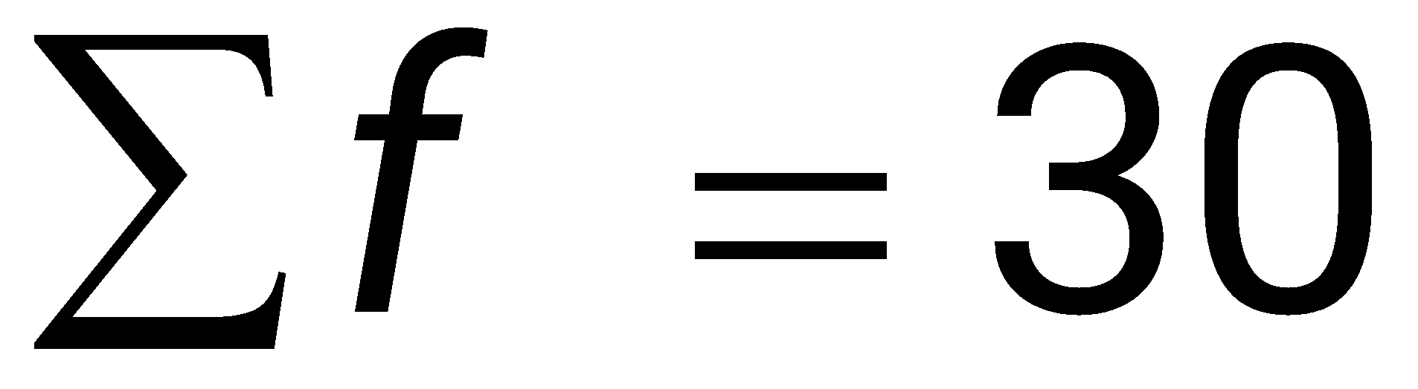
Cumulative Frequency
The cumulative frequency of a class is the sum of the frequency for that class and all the previous classes.
Ages of Students
Class
Frequency, f
Cumulative Frequency
18 – 25
13
13
26 – 33
8
21
+
34 – 41
4
25
+
42 – 49
+
3
28
Total number of students
50 – 57
+
2
30

Slide 13
Frequency Histogram
A frequency histogram is a bar graph that represents the frequency distribution of a data set.
The horizontal scale is quantitative and measures the data values.
The vertical scale measures the frequencies of the classes.
Consecutive bars must touch.
Class boundaries are the numbers that separate the classes without forming gaps between them.
The horizontal scale of a histogram can be marked with either the class boundaries or the midpoints.

Slide 14
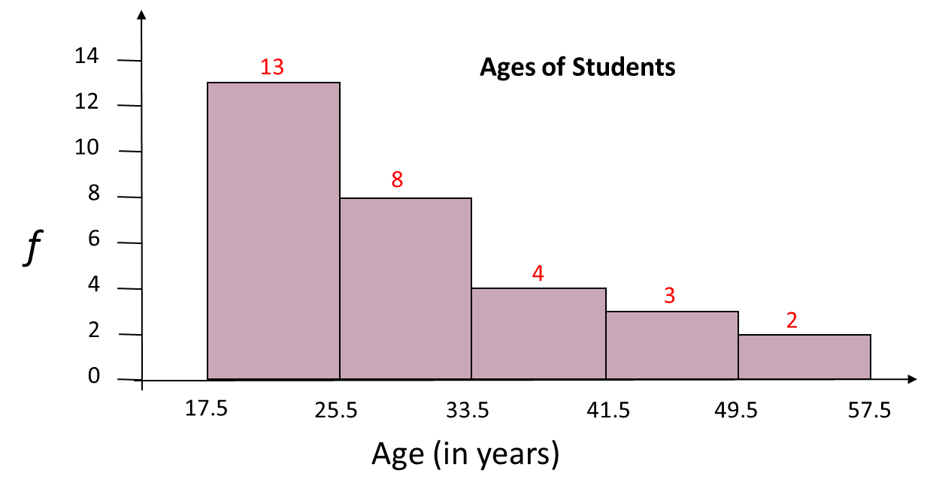
Frequency Histogram
Ages of Students
Class
Frequency, f
Class Boundaries
18 – 25
13
17.5 − 25.5
26 – 33
8
25.5 − 33.5
34 – 41
4
33.5 − 41.5
42 – 49
3
41.5 − 49.5
50 – 57
2
49.5 − 57.5

Slide 15
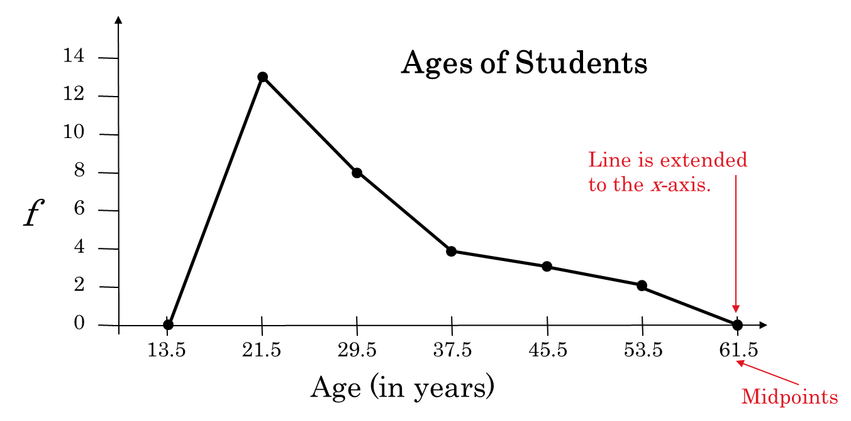
Frequency Polygon
A frequency polygon is a line graph that emphasizes the continuous change in frequencies.
Ages of Students
Class
Frequency, f
Mid-Point
18 – 25
13
21.5
26 – 33
8
29.5
34 – 41
4
37.5
42 – 49
3
45.5
50 – 57
2
53.5

Slide 16
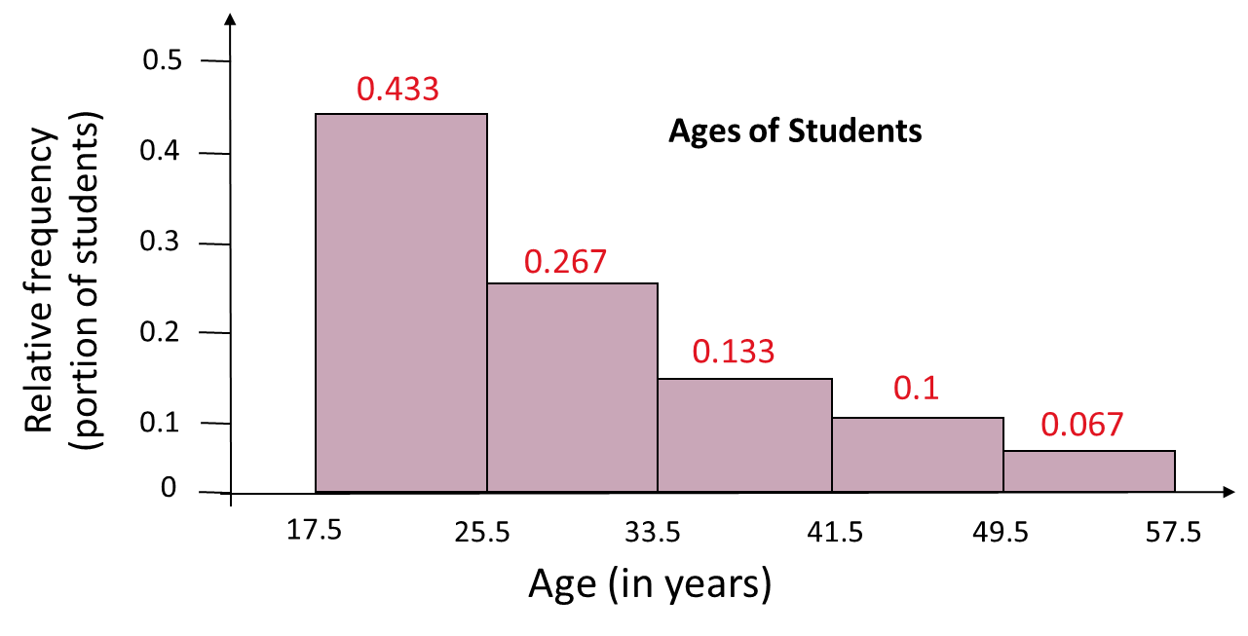
Relative Frequency Histogram
A relative frequency histogram has the same shape and the same horizontal scale as the corresponding frequency histogram.
Class | Frequency, f | Relative Frequency
18 – 25 | 13 | 0.433
26 – 33 | 8 | 0.267
34 – 41 | 4 | 0.133
42 – 49 | 3 | 0.100
50 – 57 | 2 | 0.067

Slide 17
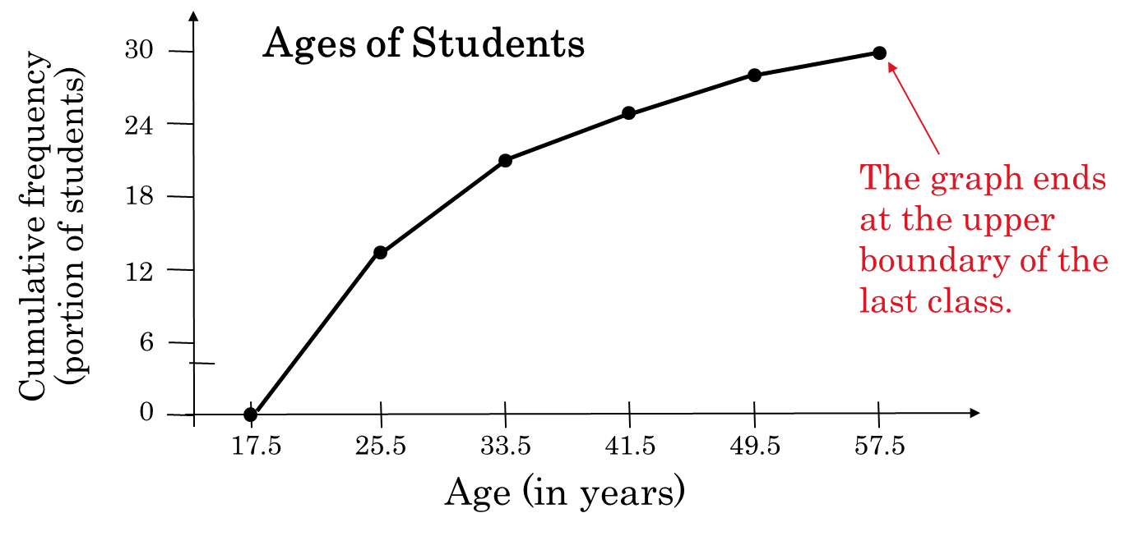
Cumulative Frequency Graph
A cumulative frequency graph or ogive, is a line graph that displays the cumulative frequency of each class at its upper class boundary.
Ages of Students
Class
Frequency, f
Cumulative Frequency
18 – 25
13
13
26 – 33
8
21
+
34 – 41
4
25
+
42 – 49
+
3
28
50 – 57
+
2
30

Slide 18
Stem-and-Leaf Plot
In a stem-and-leaf plot, each number is separated into a stem (usually the entry’s leftmost digits) and a leaf (usually the rightmost digit).
Example:
The following data represents the ages of 30 students in a statistics class. Display the data in a stem-and-leaf plot.
Ages of Students
18 | 20 | 21 | 27 | 29 | 20
19 | 30 | 32 | 19 | 34 | 19
24 | 29 | 18 | 37 | 38 | 22
30 | 39 | 32 | 44 | 33 | 46
54 | 49 | 18 | 51 | 21 | 21

Slide 19
Stem-and-Leaf Plot
Ages of Students
Key: 1|8 = 18
1
2
3
4
5
8 8 8 9 9 9
0 0 1 1 1 2 4 7 9 9
Most of the values lie between 20 and 39.
0 0 2 2 3 4 7 8 9
4 6 9
1 4
This graph allows us to see the shape of the data as well as the actual values.

Slide 20
Stem-and-Leaf Plot
Example:
a stem-and-leaf plot that has two lines for each stem.
Key: 1|8 = 18
1
1
2
2
3
3
4
4
5
5
8 8 8 9 9 9
0 0 1 1 1 2 4
7 9 9
0 0 2 2 3 4
7 8 9
From this graph, we can conclude that more than 50% of the data lie between 20 and 34.
4
6 9
1 4

Slide 21
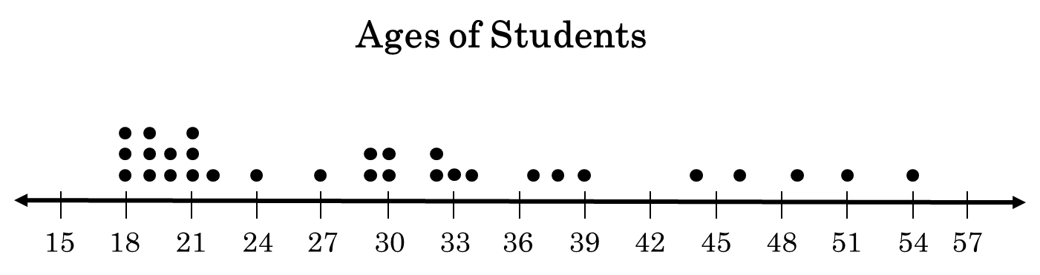
Dot Plot
In a dot plot, each data entry is plotted, using a point, above a horizontal axis.
Example:
dot plot to display the ages of the 30 students in the class.
Ages of Students
18 | 20 | 21 | 27 | 29 | 20
19 | 30 | 32 | 19 | 34 | 19
24 | 29 | 18 | 37 | 38 | 22
30 | 39 | 32 | 44 | 33 | 46
54 | 49 | 18 | 51 | 21 | 21
From this graph, we can conclude that most of the values lie between 18 and 32.

Slide 22
Pie Chart
A pie chart is a circle that is divided into sectors that represent categories. The area of each sector is proportional to the frequency of each category.
Accidental Deaths in the USA in 2002
Type | Frequency
Motor Vehicle | 43,500
Falls | 12,200
Poison | 6,400
Drowning | 4,600
Fire | 4,200
Ingestion of Food/Object | 2,900
Firearms | 1,400

Slide 23
Pie Chart
To create a pie chart for the data, find the relative frequency (percent) of each category.
Type | Frequency | Relative Frequency
Motor Vehicle | 43,500 | 0.578
Falls | 12,200 | 0.162
Poison | 6,400 | 0.085
Drowning | 4,600 | 0.061
Fire | 4,200 | 0.056
Ingestion of Food/Object | 2,900 | 0.039
Firearms | 1,400 | 0.019
n = 75,200

Slide 24
Pie Chart
Next, find the central angle. To find the central angle, multiply the relative frequency by 360°.
Ingestion
3.9%
Firearms
1.9%
Type | Frequency | Relative Frequency | Angle
Motor Vehicle | 43,500 | 0.578 | 208.2°
Falls | 12,200 | 0.162 | 58.4°
Poison | 6,400 | 0.085 | 30.6°
Drowning | 4,600 | 0.061 | 22.0°
Fire | 4,200 | 0.056 | 20.1°
Ingestion of Food/Object | 2,900 | 0.039 | 13.9°
Firearms | 1,400 | 0.019 | 6.7°
Fire
5.6%
Drowning
6.1%
Poison
8.5%
Motor vehicles
57.8%
Falls
16.2%

Slide 25
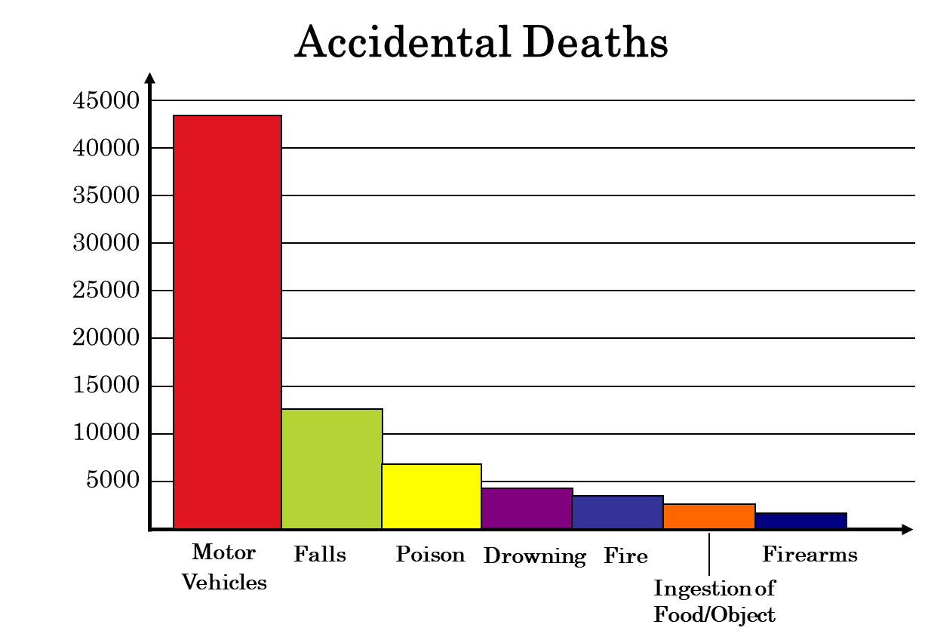
Pareto Chart
A Pareto chart is a vertical bar graph is which the height of each bar represents the frequency. The bars are placed in order of decreasing height, with the tallest bar to the left.
Accidental Deaths in the USA in 2002
Type | Frequency
Motor Vehicle | 43,500
Falls | 12,200
Poison | 6,400
Drowning | 4,600
Fire | 4,200
Ingestion of Food/Object | 2,900
Firearms | 1,400

Slide 26
Scatter Plot
In a scatter plot, the ordered pairs are graphed as points in a coordinate plane. The scatter plot is used to show the relationship between two quantitative variables.
The following scatter plot represents the relationship between the number of absences from a class during the semester and the final grade.
Absences
Grade
x
8
2
5
12
15
9
6
y
78
92
90
58
43
74
81
Final
grade
(y)
100
90
80
70
From the scatter plot, you can see that as the number of absences increases, the final grade tends to decrease.
60
50
40
0
2
4
6
8
10
12
14
16
Absences (x)

Slide 27
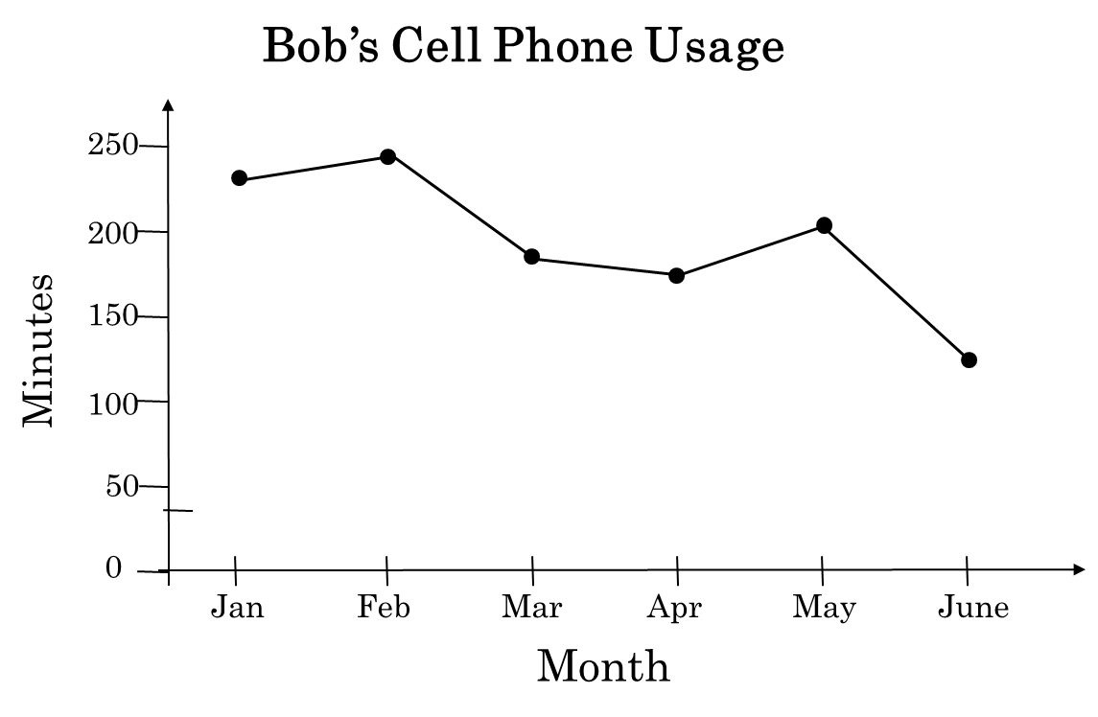
Times Series Chart
A time series chart is used to graph a time series.
A data set that is composed of quantitative data entries taken at regular intervals over a period of time is a time series.
Example:
The following table lists the number of minutes Bob used on his cell phone for the last six months.
Month | Minutes
January | 236
February | 242
March | 188
April | 175
May | 199
June | 135

Slide 28
Measure of Central Tendency

Slide 29
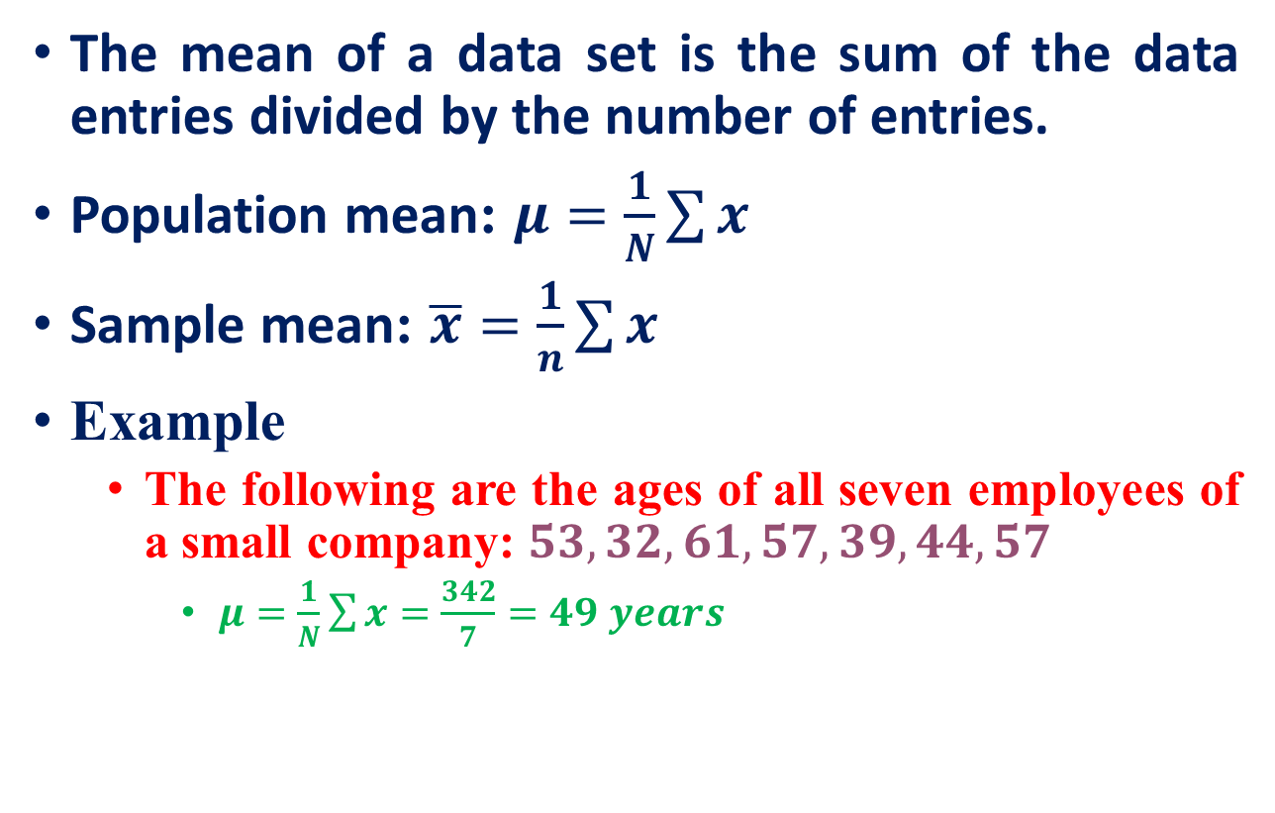
The Mean
The mean age of the employees is 49 years.

Slide 30
The Median
The median of a data set is the value that lies in the middle of the data when the data set is ordered.
If the data set has an odd number of entries, the median is the middle data entry.
If the data set has an even number of entries, the median is the mean of the two middle data entries.
Example
The following are the ages of all seven employees of a small company:
53 | 32 | 61 | 57 | 39 | 44 | 57
53
SORTED DATA
32 | 39 | 44 | 53 | 57 | 57 | 61
The median age of the employees is 53 years.

Slide 31
The Mode
The mode of a data set is the data entry that occurs with the greatest frequency.
If no entry is repeated, the data set has no mode.
If two entries occur with the same greatest frequency, each entry is a mode and the data set is called bimodal.
Example
The following are the ages of all seven employees of a small company:
57
57
53 | 32 | 61 | 57 | 39 | 44 | 57
The mode age of the employees is 57 years.

Slide 32
Outliers
An outlier is a data point or observation whose value is quite different from the others in the data set being analyzed.
no absolute agreement about how to define outliers

Slide 33
Comparing the Mean, Median and Mode
Example
A 29-year-old employee joins the company, and the ages of the employees are now:
Recalculate the mean, the median, and the mode.
Mean = 46.5
Median = 48.5
Mode = 57
53 | 32 | 61 | 57 | 39 | 44 | 57
53 | 32 | 61 | 57 | 39 | 44 | 57 | 29
The mean takes every value into account but is affected by the outlier.

Slide 34
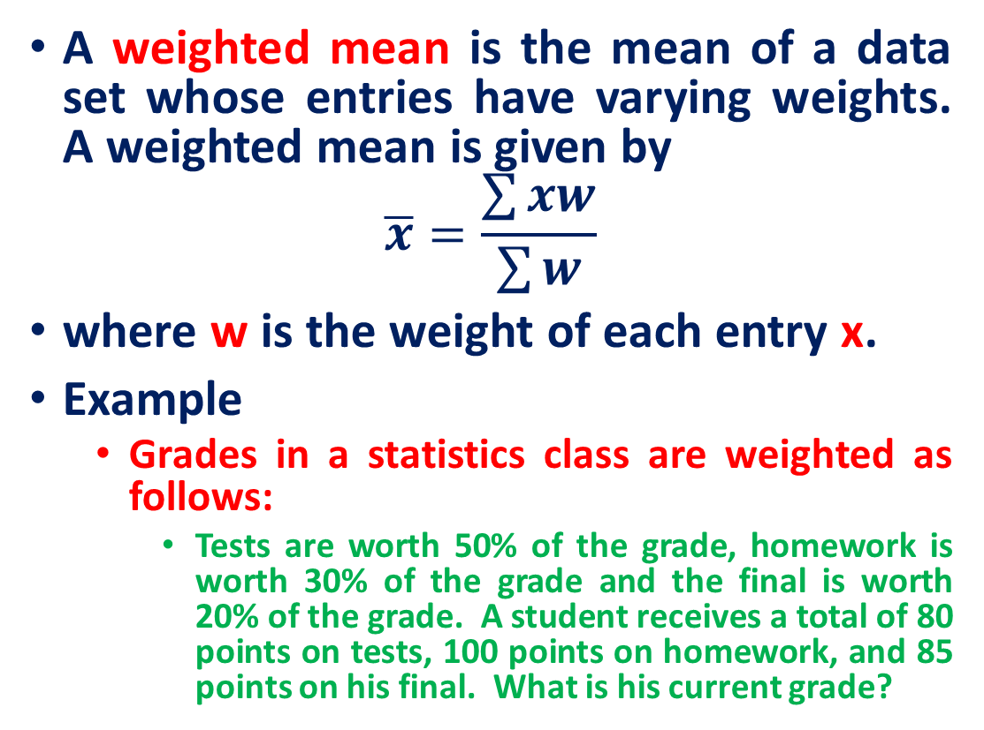
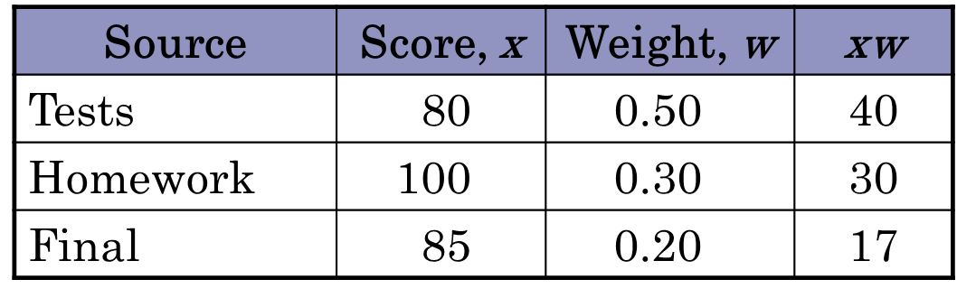
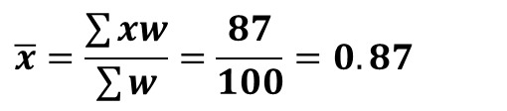
Weighted Mean

Slide 35
Mean of a Frequency Distribution
The mean of a frequency distribution for a sample is approximated by
where x and f are the midpoints and frequencies of the classes.

Slide 36
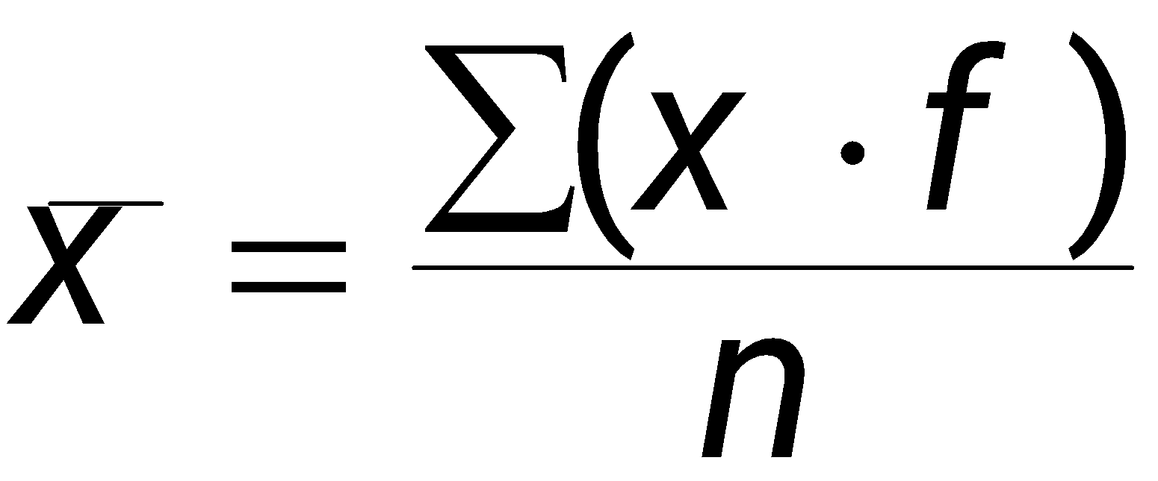
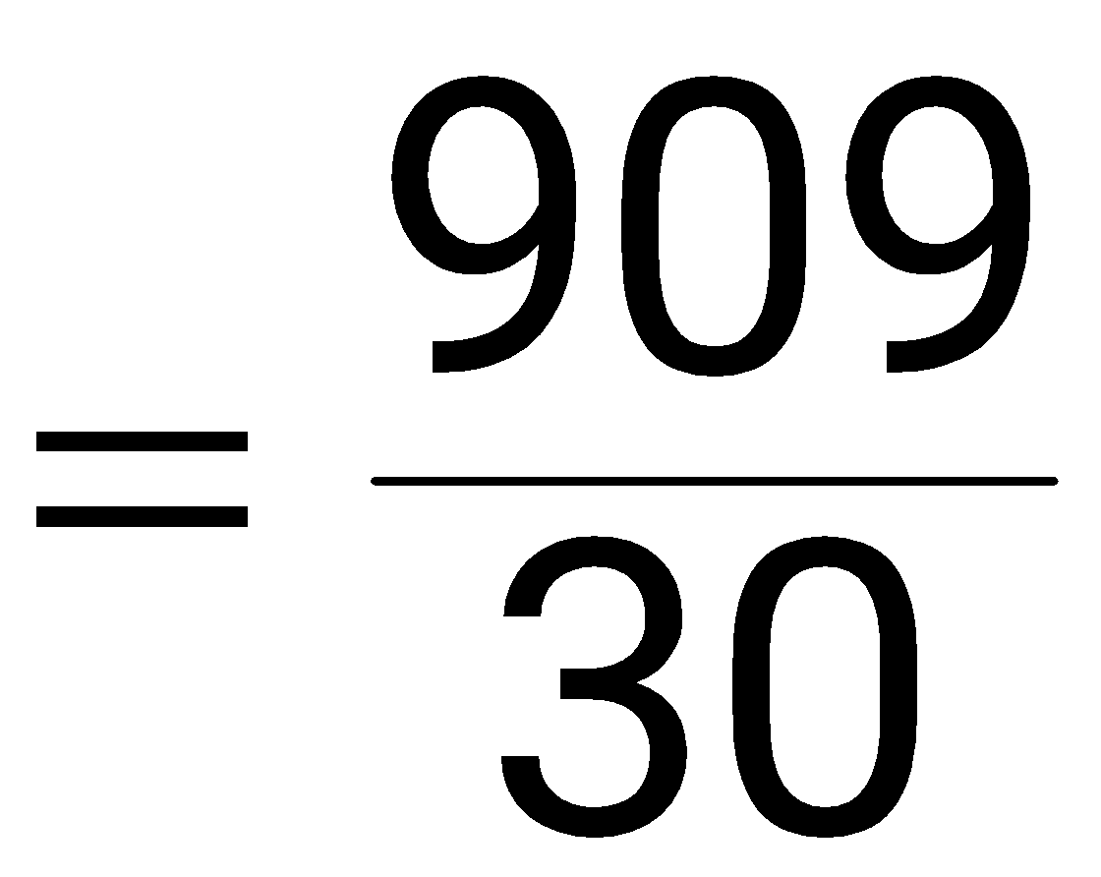
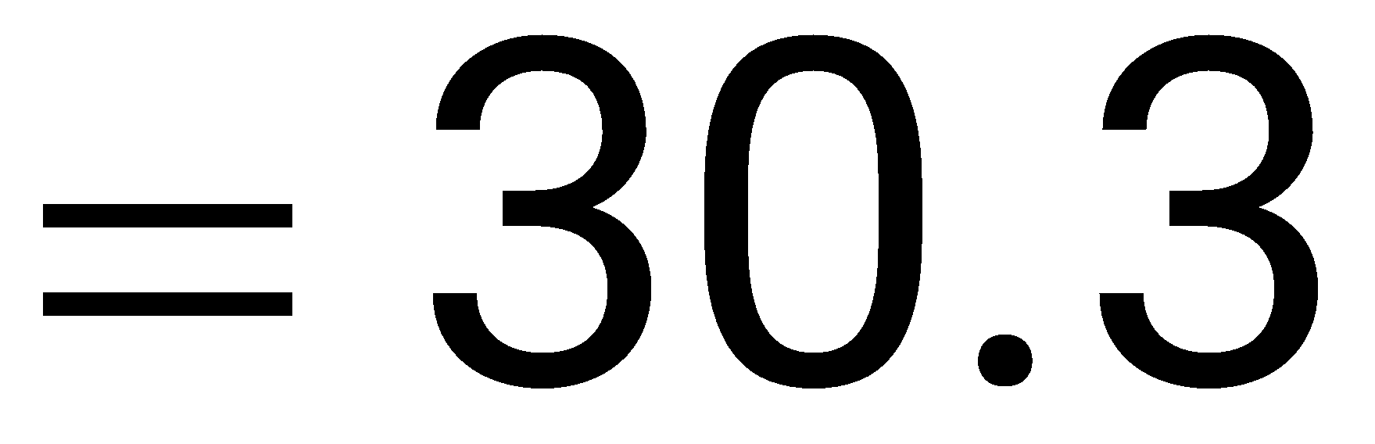
Mean of a Frequency Distribution
Class | x | f | (x · f )
18 – 25 | 21.5 | 13 | 279.5
26 – 33 | 29.5 | 8 | 236.0
34 – 41 | 37.5 | 4 | 150.0
42 – 49 | 45.5 | 3 | 136.5
50 – 57 | 53.5 | 2 | 107.0
 |  | n = 30 | Σ = 909.0
The mean age of the students is 30.3 years.

Slide 37
Shapes of Distributions
A frequency distribution is symmetric when a vertical line can be drawn through the middle of a graph of the distribution and the resulting halves are approximately the mirror images.
10 Annual Incomes
15,000
20,000
22,000
24,000
25,000
25,000
26,000
28,000
30,000
35,000
5
Income
4
f
3
2
1
0
$25000
mean = median = mode
= $25,000

Slide 38
Shapes of Distributions
A frequency distribution is skewed if the “tail” of the graph elongates more to one side than to the other.
A distribution is skewed left (negatively skewed) if its tail extends to the left.
A distribution is skewed right (positively skewed) if its tail extends to the right.
10 Annual Incomes
0
20,000
22,000
24,000
25,000
25,000
26,000
28,000
30,000
35,000
5
Income
4
f
3
2
1
0
mean = $23,500
median = mode = $25,000
$25000
Mean < Median

Slide 39
Skewed Right Distribution
10 Annual Incomes
15,000
20,000
22,000
24,000
25,000
25,000
26,000
28,000
30,000
1,000,000
5
Income
4
f
3
2
1
0
$25000
mean = $121,500
median = mode = $25,000
Mean > Median

Slide 40
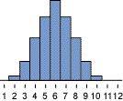
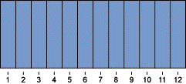
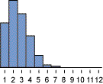
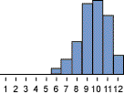
Summary of Shapes of Distributions
Symmetric
Uniform
Mean = Median
Skewed right
Skewed left
Mean > Median
Mean < Median

Slide 41
Measures of Dispersion

Slide 42
Range
The range of a data set is the difference between the maximum and minimum date entries in the set.
Range = (Maximum data entry) – (Minimum data entry)
Example:
The following data are the closing prices for a certain stock on ten successive Fridays.
Stock | 56 | 56 | 57 | 58 | 61 | 63 | 63 | 67 | 67 | 67
The range is 67 – 56 = 11.

Slide 43

Deviation
The deviation of an entry x in a population data set is the difference between the entry and the mean μ of the data set.
Deviation of x = x – μ
Example:
The following data are the closing prices for a certain stock on five successive Fridays.
Stock
x
Deviation
x – μ
56
56 – 61 = – 5
58
58 – 61 = – 3
61
61 – 61 = 0
63
63 – 61 = 2
The mean stock price is
μ = 305/5 = 61.
67
67 – 61 = 6
Σx = 305
Σ(x – μ) = 0

Slide 44
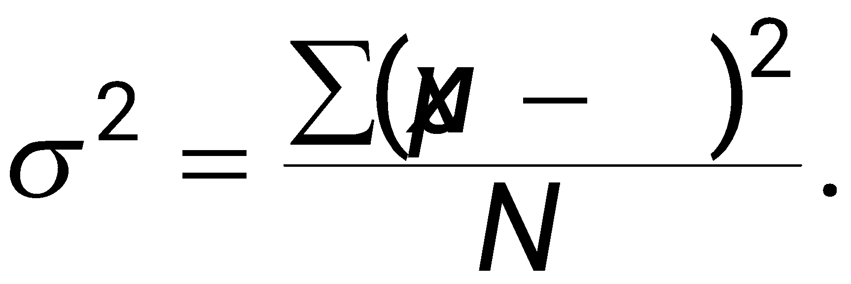
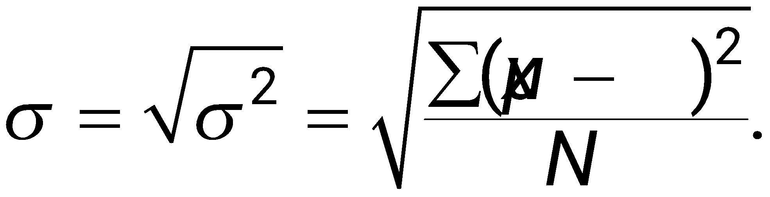
Variance and Standard Deviation
The population variance of a population data set of N entries is
The population standard deviation of a population data set of N entries is the square root of the population variance.

Slide 45
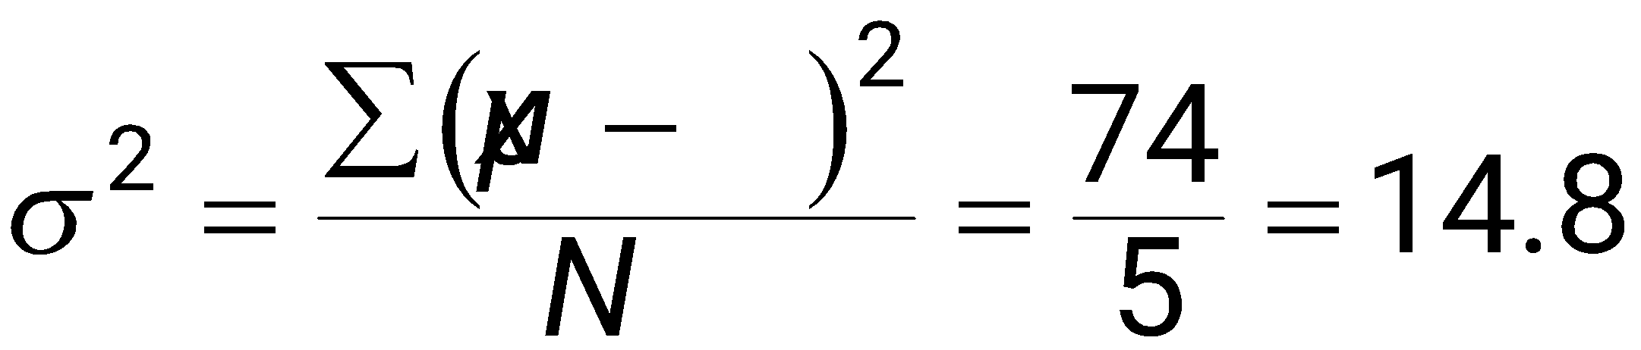
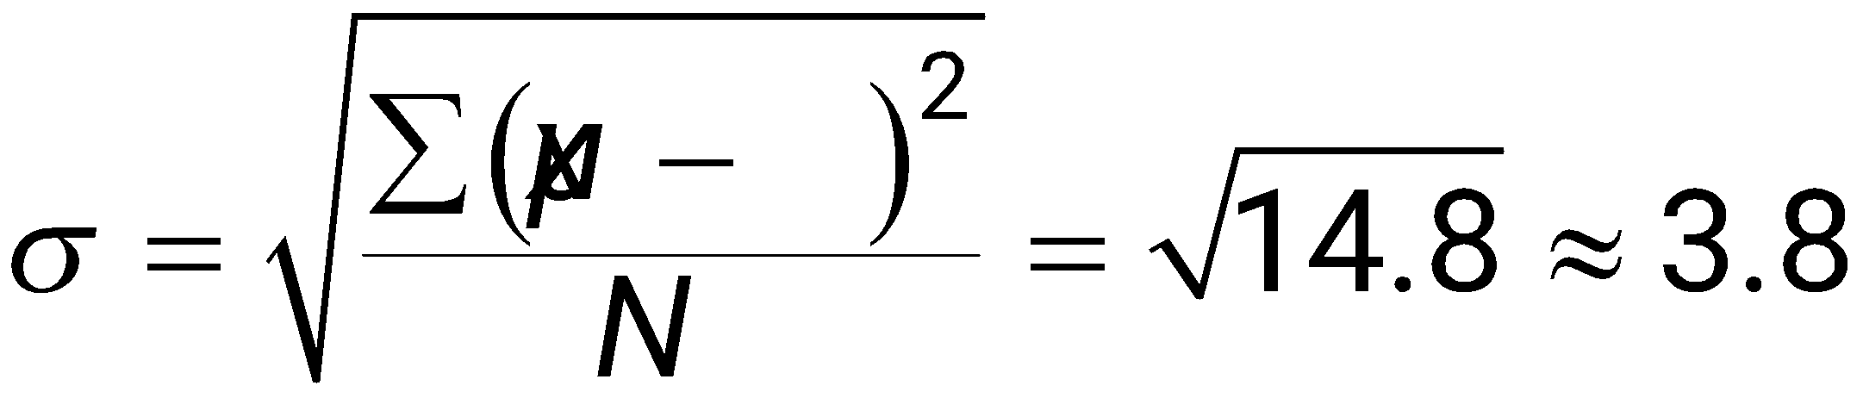
Finding the Population Standard Deviation
Example:
The following data are the closing prices for a certain stock on five successive Fridays. The population mean is 61.
Stock x | Deviation x – μ | Squared (x – μ)²
56 | – 5 | 25
58 | – 3 | 9
61 | 0 | 0
63 | 2 | 4
67 | 6 | 36
Σx = 305 | Σ(x – μ) = 0 | Σ(x – μ)² = 74
3.85
σ ≈ $3.85

Slide 46
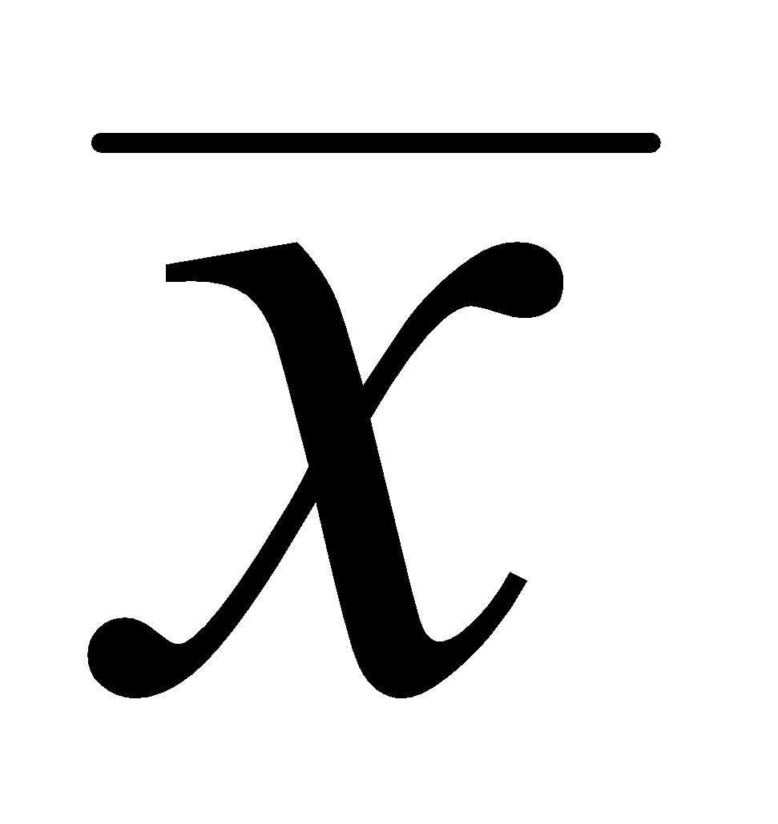
Interpreting Standard Deviation
standard deviation is a measure of the typical amount an entry deviates from the mean.
The more the entries are spread out, the greater the standard deviation.
14
14
12
= 4
s = 1.18
12
= 4
s = 0
10
10
Frequency
Frequency
8
8
6
6
4
4
2
2
0
0
2
4
6
2
4
6
Data value
Data value

Slide 47
Empirical Rule (68-95-99.7%)
Empirical Rule
For data with a (symmetric) bell-shaped distribution, the standard deviation has the following characteristics.
About 68% of the data lie within one standard deviation of the mean.
About 95% of the data lie within two standard deviations of the mean.
About 99.7% of the data lie within three standard deviation of the mean.

Slide 48
Empirical Rule (68-95-99.7%)
99.7% within 3 standard deviations
95% within 2 standard deviations
68% within 1 standard deviation
34%
34%
2.35%
2.35%
13.5%
13.5%
–4
–3
–2
–1
0
1
2
3
4

Slide 49
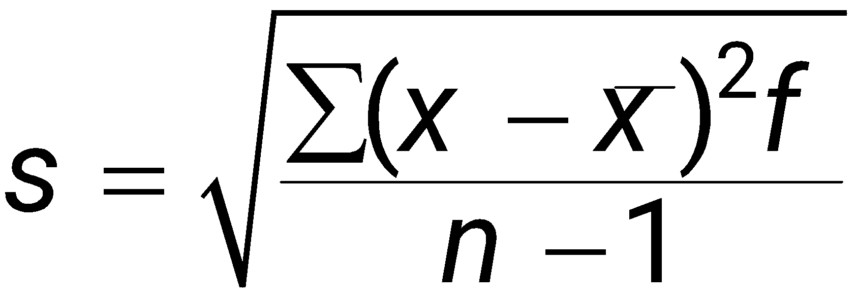
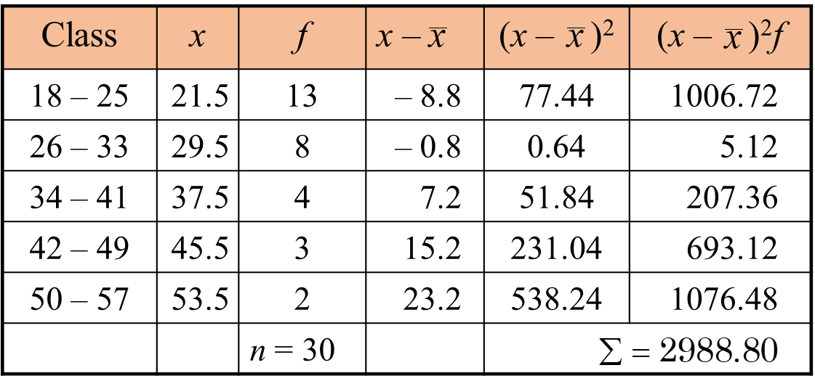
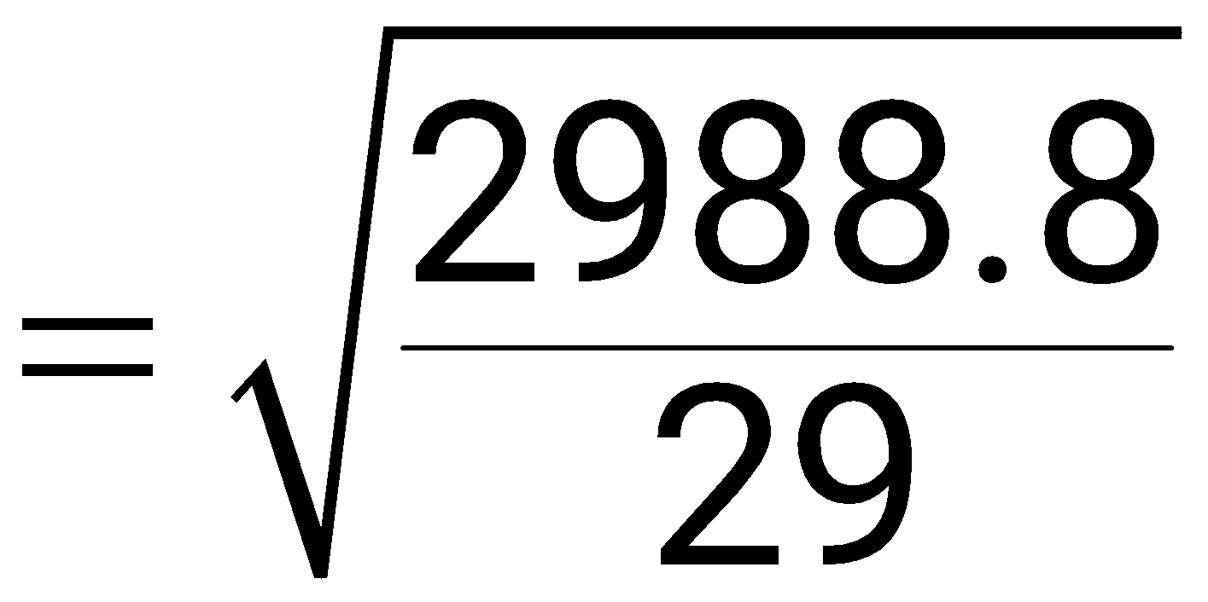
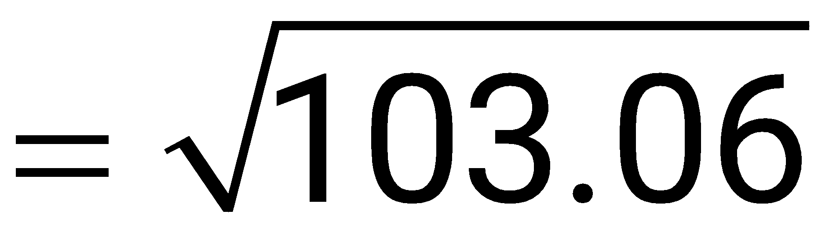
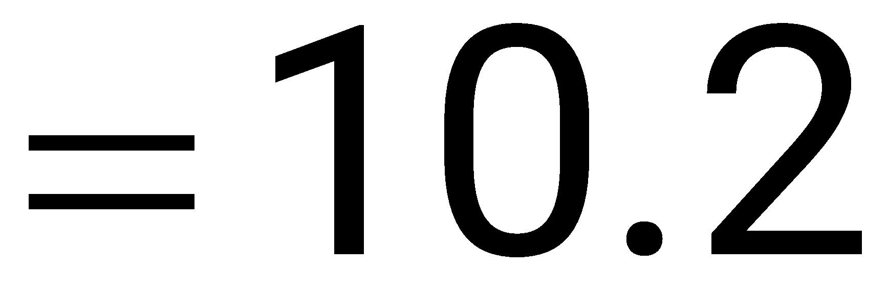
Standard Deviation for Grouped Data
Sample standard deviation =
where n = Σf is the number of entries in the data set, and x is the data value or the midpoint of an interval.

Slide 50
Measures of Position

Slide 51

Quartiles
Median
Q₁
Q₂
Q₃
0
25
50
75
100
Q₁ is the median of the data below Q₂.
Q₃ is the median of the data above Q₂.

Slide 52
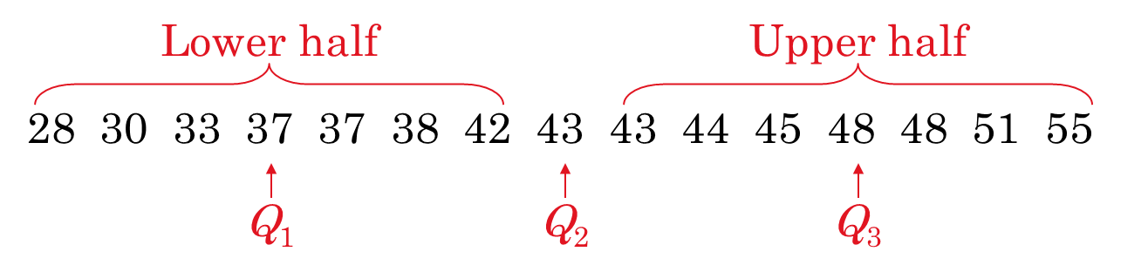
Finding Quartiles
Example:
The quiz scores for 15 students are listed below.
28 43 48 51 43 30 55 44 48 33 45 37 37 42 38
Order the data.
About one fourth of the students scores 37 or less; about one half score 43 or less; and about three fourths score 48 or less.

Slide 53
Interquartile Range
The interquartile range (IQR) of a data set is the difference between the third and first quartiles.
Interquartile range (IQR) = Q3 – Q1.
Example:
The quartiles for 15 quiz scores are listed below. Find the interquartile range.
Q₁ = 37
Q₂ = 43
Q₃ = 48
(IQR) = Q₃ – Q₁
The quiz scores in the middle portion of the data set vary by at most 11 points.
= 48 – 37
= 11

Slide 54
Box and Whisker Plot
A box-and-whisker plot is an exploratory data analysis tool that highlights the important features of a data set.
The five-number summary is used to draw the graph.
The minimum entry
Q1
Q2 (median)
Q3
The maximum entry
Example:
Use the data from the 15 quiz scores to draw a box-and-whisker plot.
28 30 33 37 37 38 42 43 43 44 45 48 48 51 55

Slide 55
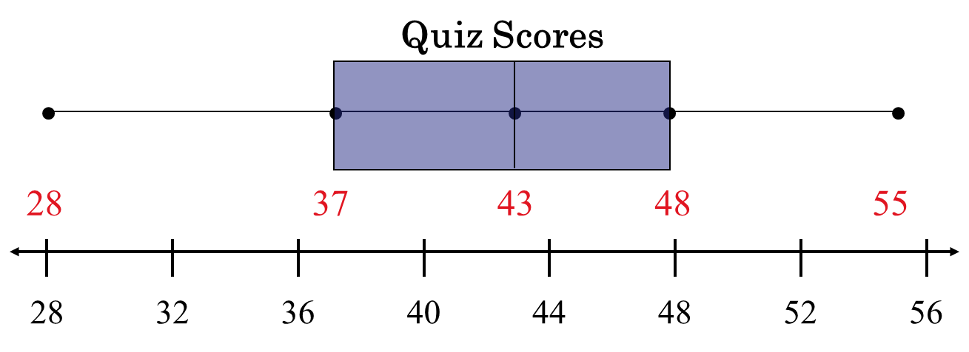
Box and Whisker Plot
Five-number summary
The minimum entry
Q1
Q2 (median)
Q3
The maximum entry
Whisker: Indicate variability outside the upper and lower quartiles.

Slide 56
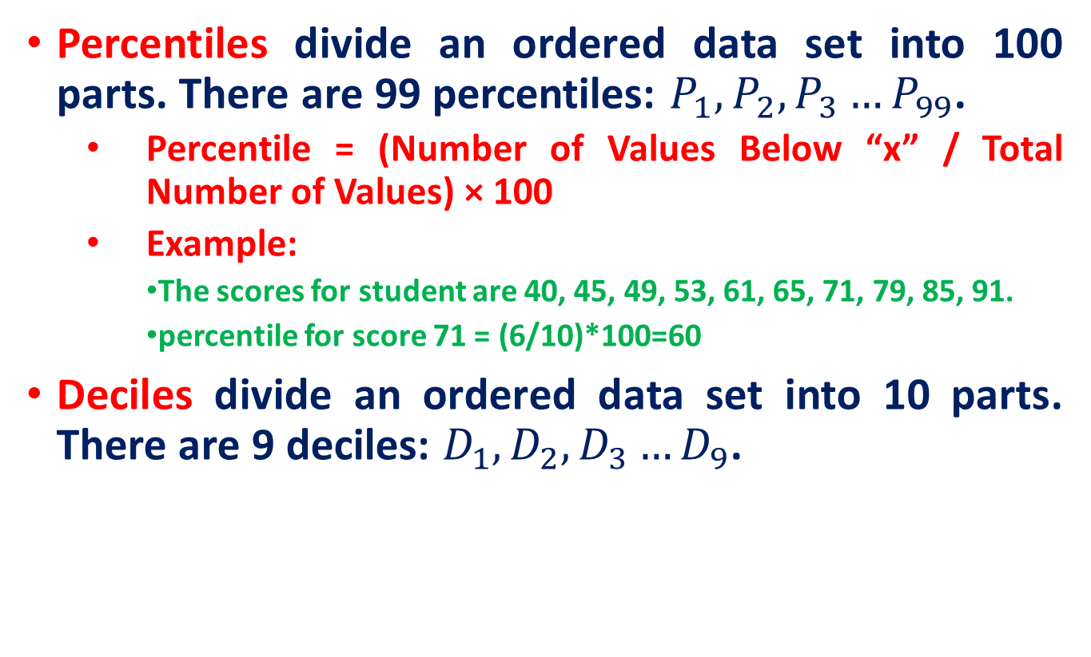
Percentiles and Deciles

Slide 57
Reference
Probability and Statistics by Prof. Kevin M. Riordan

